Slide 1
ShanghaiTech University
EE 115B: Digital Circuits
Fall 2021
Lecture 1
Hengzhao Yang
September 14, 2021

Slide 2

EE115 Analog and Digital Circuits
Topic 1: Introduction to Digital Fundamentals
Prof. Yajun Ha
ShanghaiTech University
Shanghai, China
This set of slides is by © Pearson Education

Slide 3
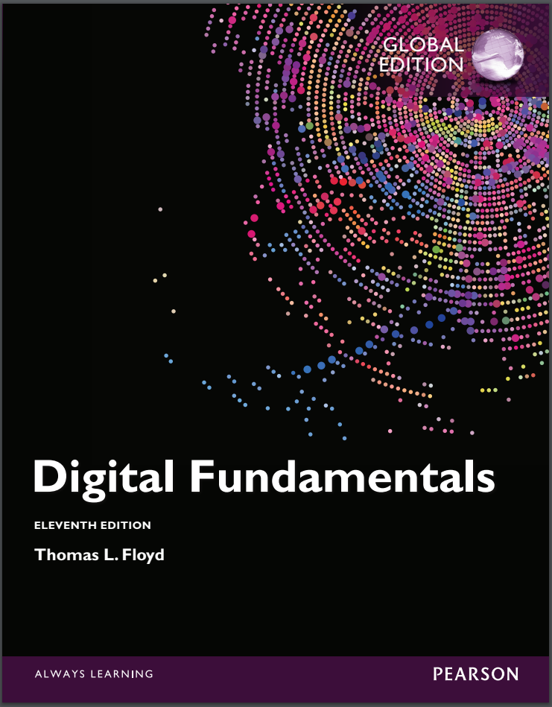
Textbook For This Course
Thomas L. Floyd,
Digital Fundamentals,
International Edition, Year: 2015, ISBN 10: 1-292-07598-8, Pearson Education Limited.
Please focus on Chapters 1-7.
Widely used textbook on the digital fundamentals related courses.

Slide 4

Introduction to Digital Fundamentals
Digital and Analog Quantities
Binary Digits, Logic Levels and Digital Waveforms
Basic Logic Functions
Combinational and Sequential Logic Functions
Programmable Logic Devices
Fixed-Function Logic Devices
Test and Measurement Instruments
Prof. Yajun Ha
Notes:
Title

Slide 5
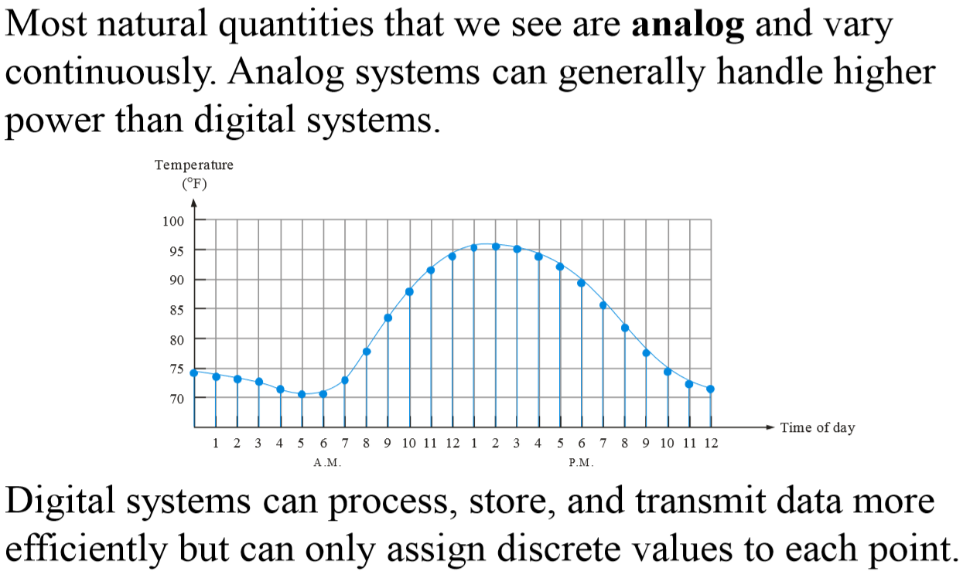
Analog Quantities
Prof. Yajun Ha
Notes:
Title

Slide 6
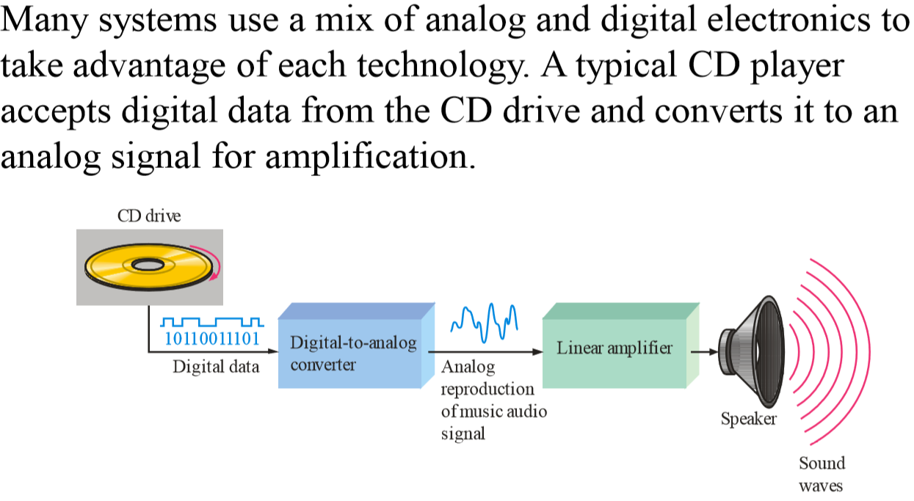
Analog and Digital Systems
Prof. Yajun Ha
Notes:
Title

Slide 7
Introduction to Digital Fundamentals
Digital and Analog Quantities
Binary Digits, Logic Levels and Digital Waveforms
Basic Logic Functions
Combinational and Sequential Logic Functions
Programmable Logic Devices
Fixed-Function Logic Devices
Test and Measurement Instruments
Prof. Yajun Ha
Notes:
Title

Slide 8
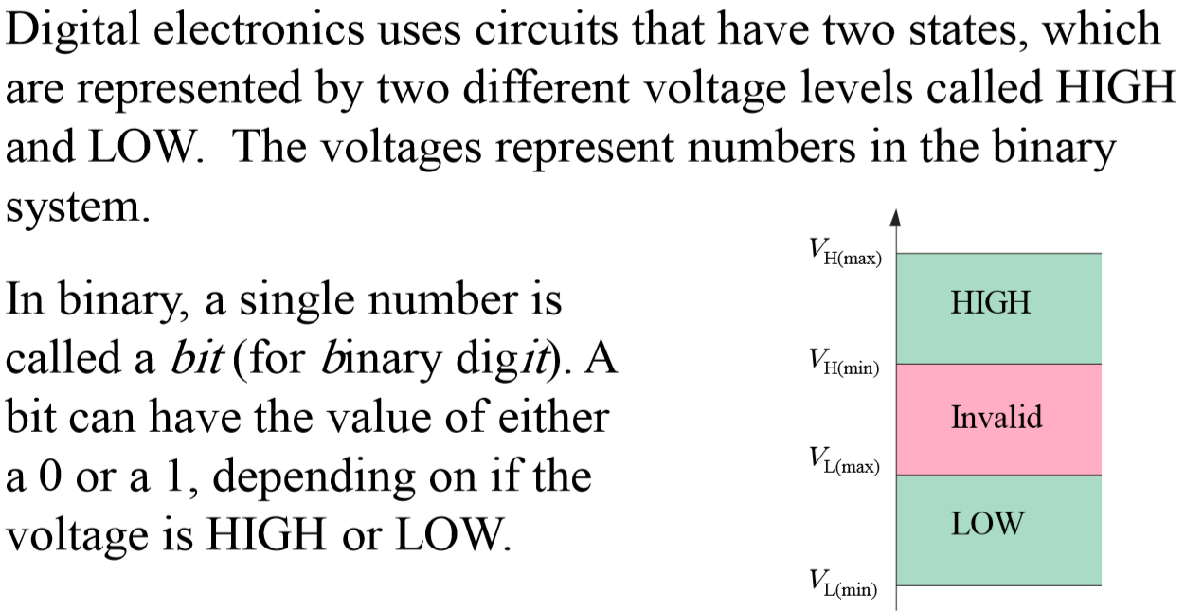
Binary Digits and Logic Levels
Prof. Yajun Ha
Notes:
Title

Slide 9
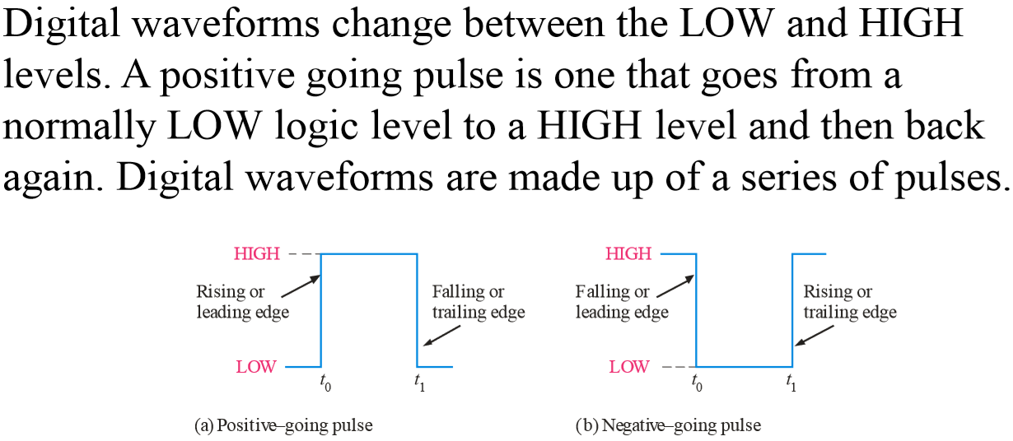
Digital Waveforms
Prof. Yajun Ha
Notes:
Title

Slide 10
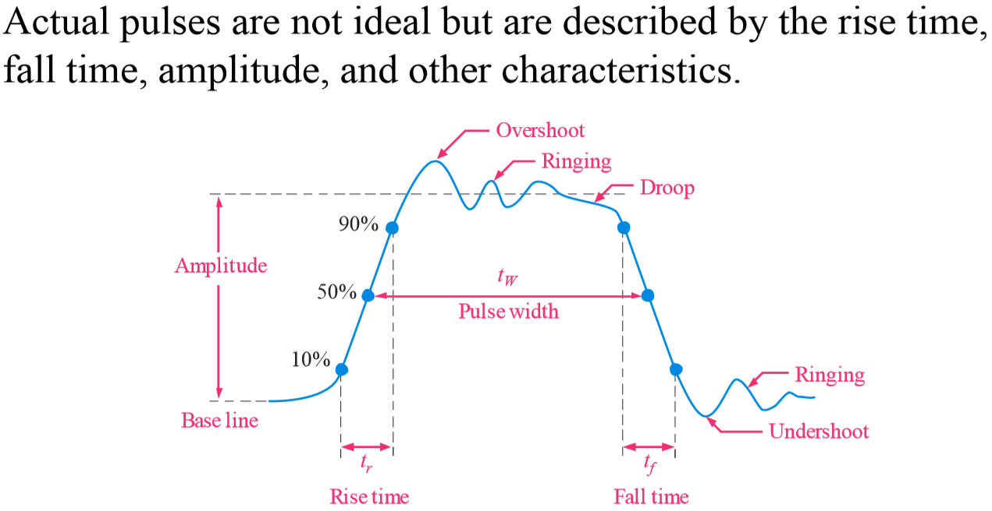
Pulse Definitions
Prof. Yajun Ha
Notes:
Title

Slide 11
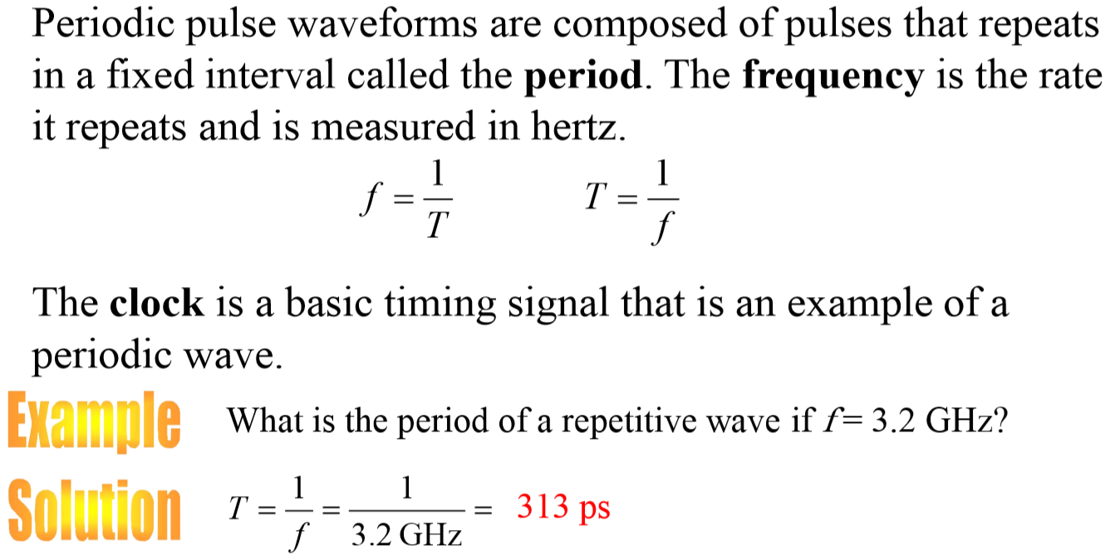
Periodic Pulse Waveforms
Notes:
Title

Slide 12
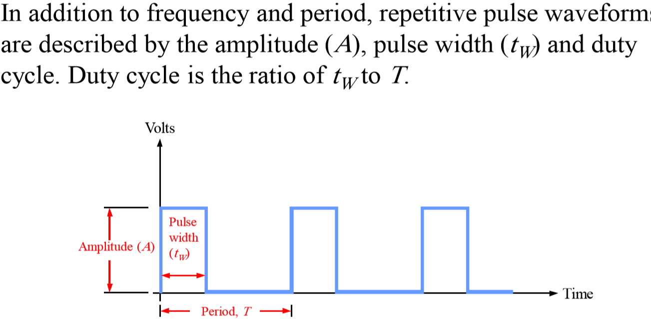
Pulse Definitions
Notes:
Title

Slide 13
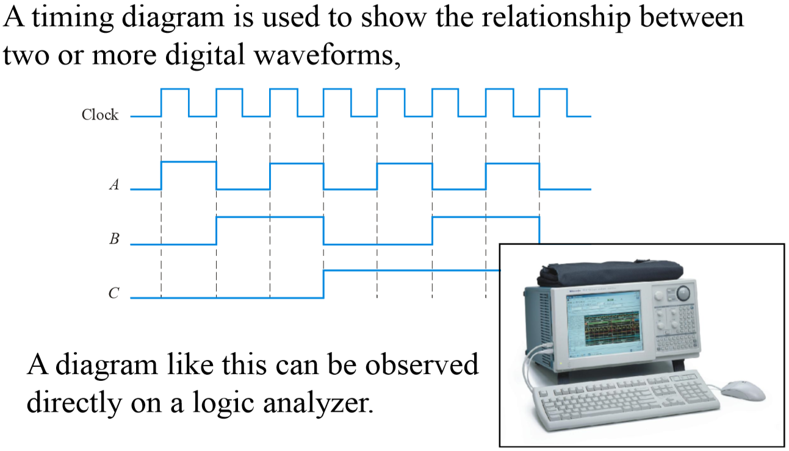
Timing Diagrams
Notes:
Title

